Slide 1
Simple Linear Regression
Simple Linear Regression
Standard Error of Estimate SEE
Least Squares Method
Correlation

Slide 2

Uses of Linear Regression

Slide 3
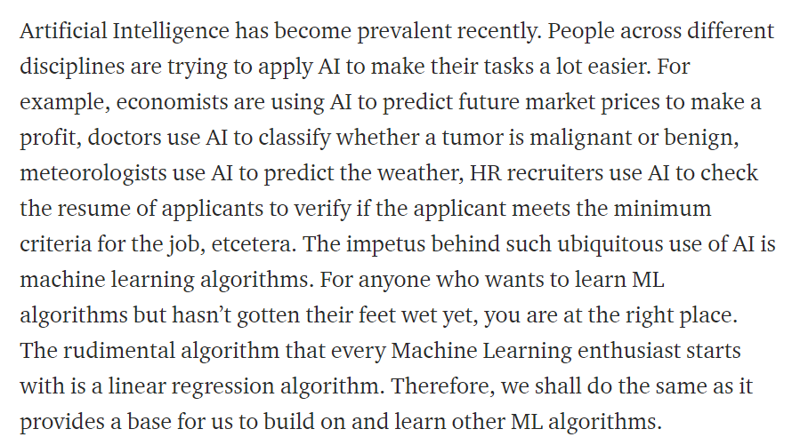

Slide 4
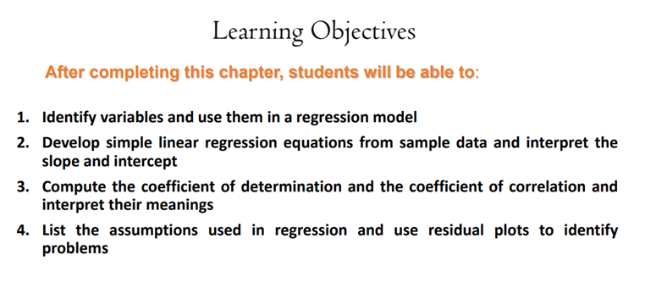

Slide 5
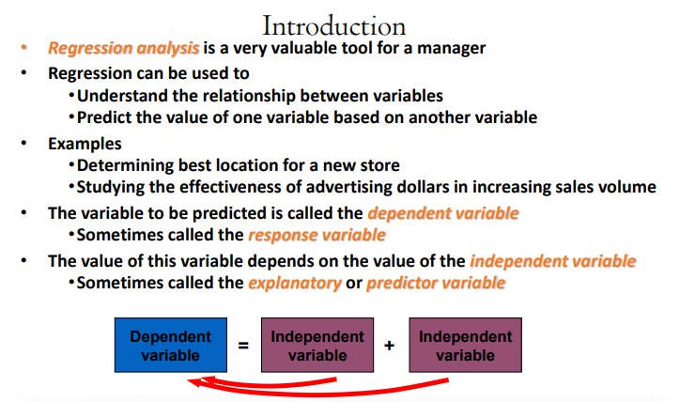


Slide 6
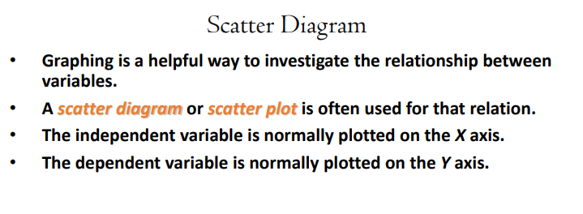

Slide 7
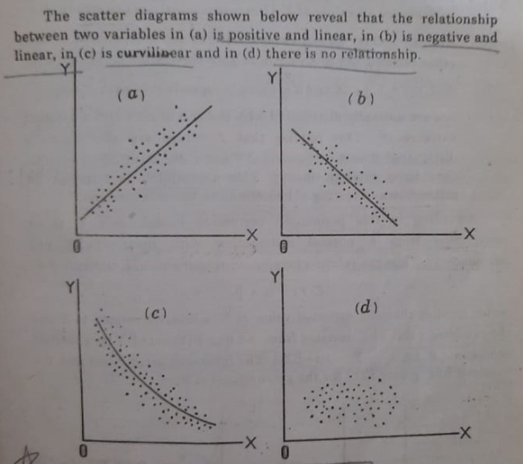

Scatter Diagram

Slide 8
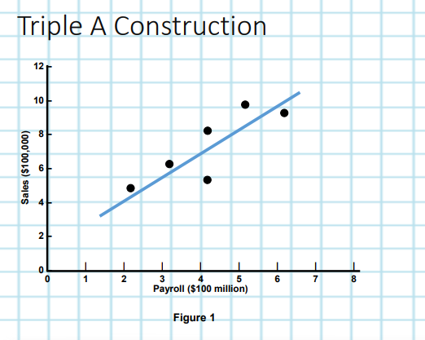

Slide 9
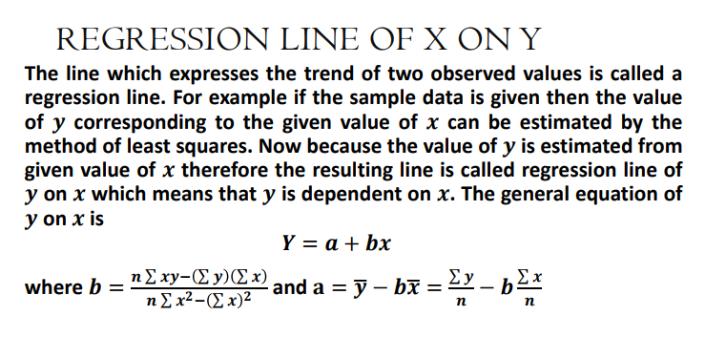


Slide 10
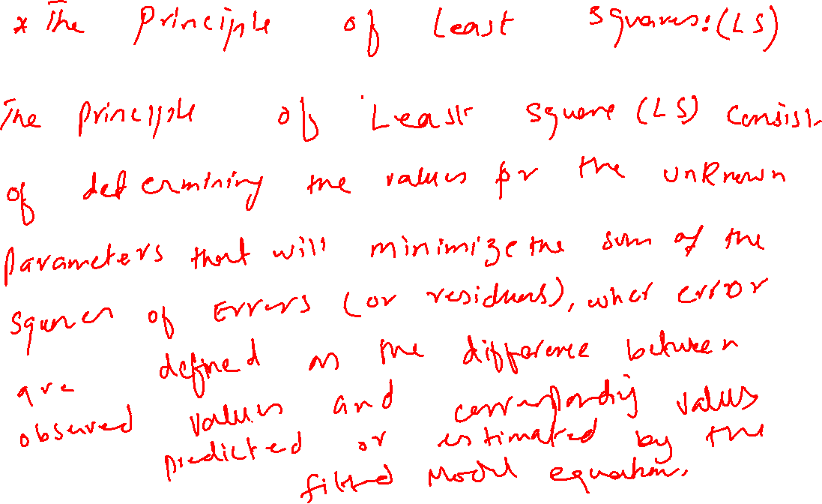

Slide 11


Slide 12


Slide 13


Slide 14


Slide 15


Slide 16


Slide 17
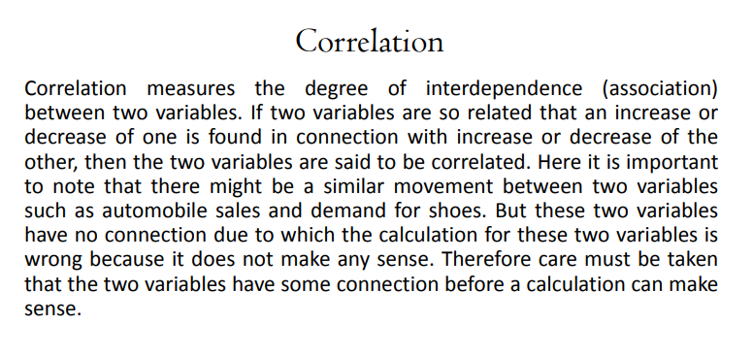

Slide 18
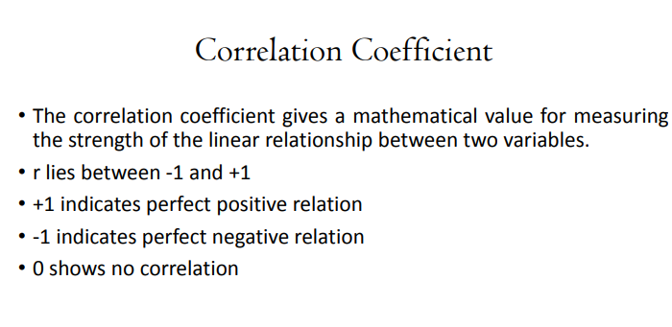
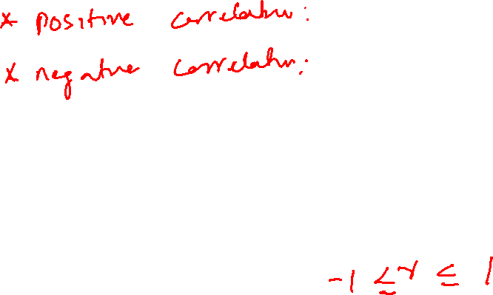

Slide 19
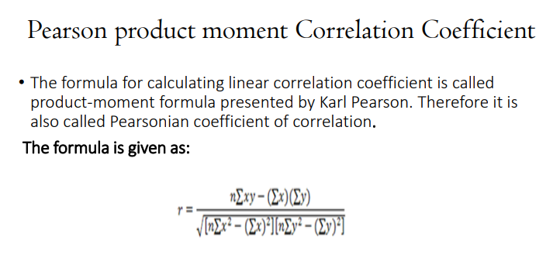


Slide 20
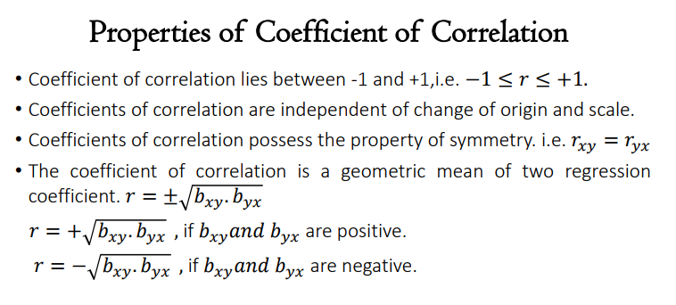

Slide 21
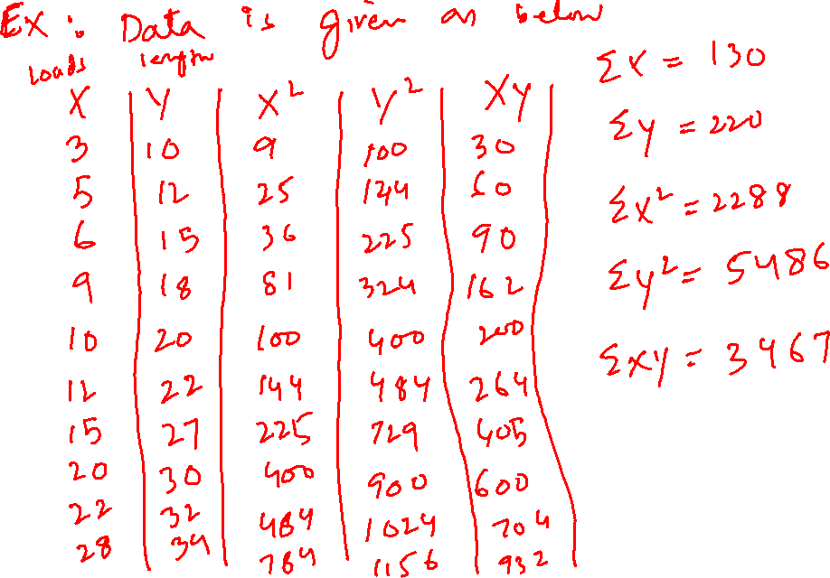

Slide 22


Slide 23


Slide 24


Slide 25



Slide 26


Slide 27


Slide 28


